Slide 1
Pennsylvania Road Network Analysis
Brandon Wong II, Mengchun Jiang, Jinglin Yang, Yijia Yuan

Slide 2
Contents
1. Introduction
2. Dataset Overview
3. Methodology
4. Subgraph Generation
5. Community Detection
6. Network Metrics & Resilience Analysis
7. Results & Discussion

Slide 3
Introduction/Motivation
Target of Analysis: Pennsylvania Road Network
Focus of Research:
Network structure
Network connectivity
Network resilience
Some Real World Questions to be Answered:
How does transportation networks respond to random failures and disruptions?
Where are the transportation hubs and metropolitan areas that serves as critical intersections?
Potentially many more…

Slide 4
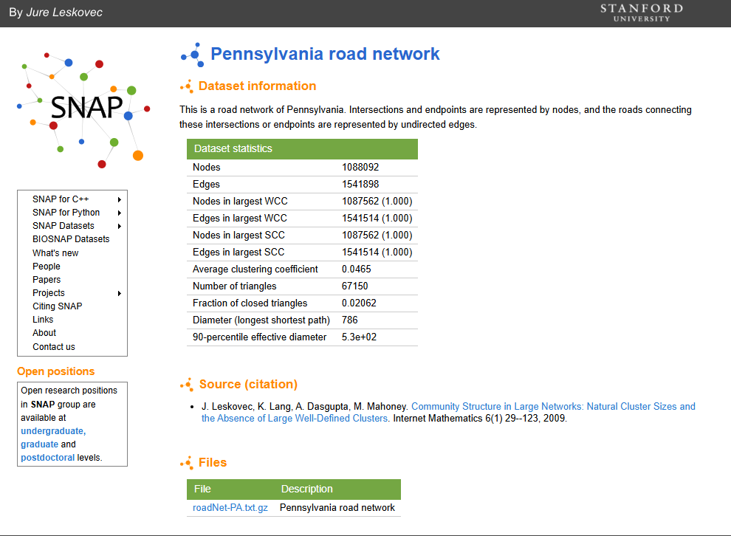
Dataset: roadNet-PA
Notes:
The dataset contains about 1 million nodes and 1.5 million edges, making it a large-scale real-world network, capable of answering those questions.

Slide 5
Methodology
We imported the data using `read.table` and then called `graph_from_data_frame` to convert our dataset into an actual graph object.
Upon running this, we noticed that we have a graph object with 1088092 nodes and 3083796 edges, which is exactly double the number of edges we should have in our network. What happened here, is that our .txt file represents an undirected edge by listing it twice, i.e A -> B and B -> A, meaning when we call our graph_from_data_frame function, it treats these as two separate edges between the two nodes and thus we get double the edges we should.
To fix this, we called the simplify function on our imported network, which removes duplicate edges and self-loops, leaving us with the correct number of nodes and edges in our network.

Slide 6
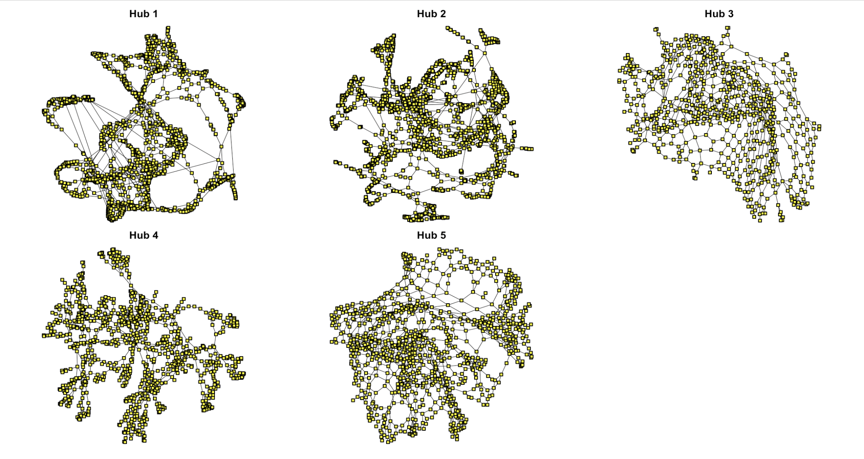
Subgraph Generation
The sampling method we employed involves iteratively building out a neighborhood at an order of 15 steps from a high-degree node and then removing these used nodes for the next iteration.
The idea behind our subgraph generation method is to mimic selecting urban centers and their surrounding areas.

Slide 7
Visualization of Five Different Subgraphs

Slide 8
Community Detection Results
Walktrap and Fast Greedy are implemented on all 5 subnetworks to detect neighborhoods/blocks within each hub. Since they cluster the intersections with different mechanisms, we want to compare the performance of different algorithms and find the one that best fit out network with higher modularity.
The Walktrap uses the idea of random walks to identify densely connected "towns" within a network. The intuition is that if you were to take a short random walk from a node (3-5 steps), then you are more likely to stay within the same "town" then jump to a different one. This makes the algorithm better at detecting smaller "towns" within a hub.
The Fast Greedy algorithm tries to maximize Modularity. It starts by treating each intersection as its own separate community, then greedily merges other communities that yield the largest increase in modularity. Making this algorithm good for looking at the global structure of the network and computationally quick. The downside to this algorithm is that it tends to miss smaller neighborhoods since it focuses on maximizing modularity.

Slide 9
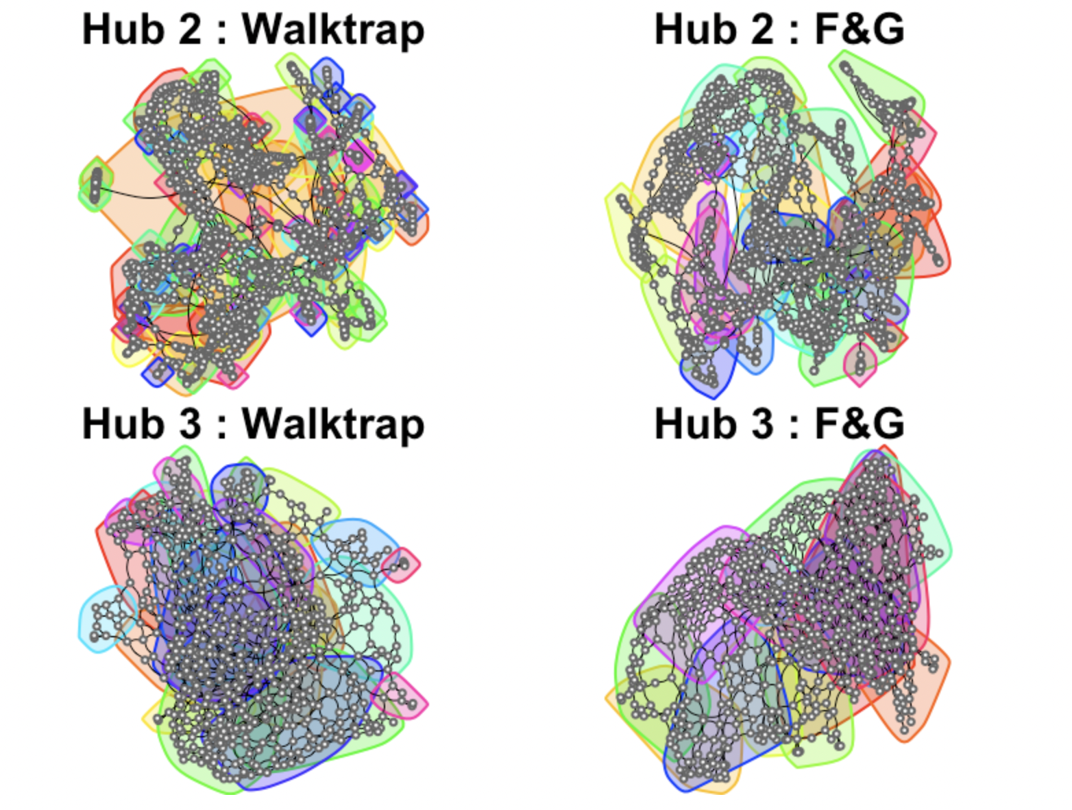
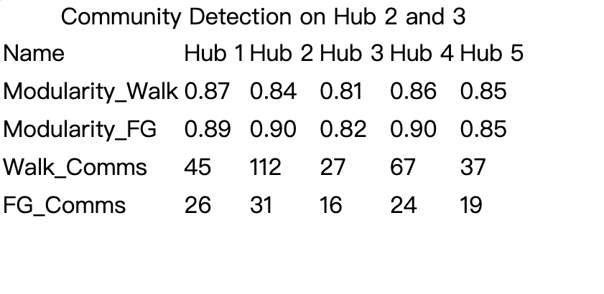
Community Detection Visualization
The comparison table for each hub
Visualization graph for hub2 &3
by two mechanism.

Slide 10
Network Metrics & Resilience Analysis
We simulate targeted scenarios such as road closures, infrastructure failures, or disaster damage at intersections with the most traffic flow in the road network.
The goal is to observe how the town's connectivity and structure degrade under such disruptions, specifically examining whether the town fragments into isolated regions, are there any unreachable intersections, and how overall connectivity metrics change after each removal.
This provides insight into the town's infrastructural vulnerability and helps identify which intersections are most critical to maintain for ensuring a functional road network.

Slide 11
Results & Discussion
This analysis revealed that Pennsylvania's road network demonstrates low transitivity, low density, and extremely high modularity across all five subgraphs, confirming that roads form tight geographic clusters with predominantly linear structures rather than interconnected grids. Overall, the resilience analysis demonstrated that while Pennsylvania's road network handles random failures reasonably well, some hubs remain vulnerable to targeted removal of articulation points that simultaneously carry high traffic flow and structurally hold the network together.
Since roadNet-PA contains no edge or node attributes beyond basic connectivity, a key future direction would be enriching the network by merging external datasets add edge weights such as road distance, speed limits, traffic volume, or road type (highway vs local street).

Slide 12
Thank You
Questions?

